Slide 1
Stallion Smart Nursing Station Application
Smart Nursing & Patients Tracking Application

Slide 2
Overall Solution
Build first-class modern digital hospital
Adopt advanced medical technology
Improve the working efficiency of health care staff
Reduce labor intensity of health care staff
Improve the utilization of hospital resources
Serve more patients, ease the financial burden of the patients
Increase hospital benefit, lay a solid foundation for a better and faster development of the hospital

Slide 3
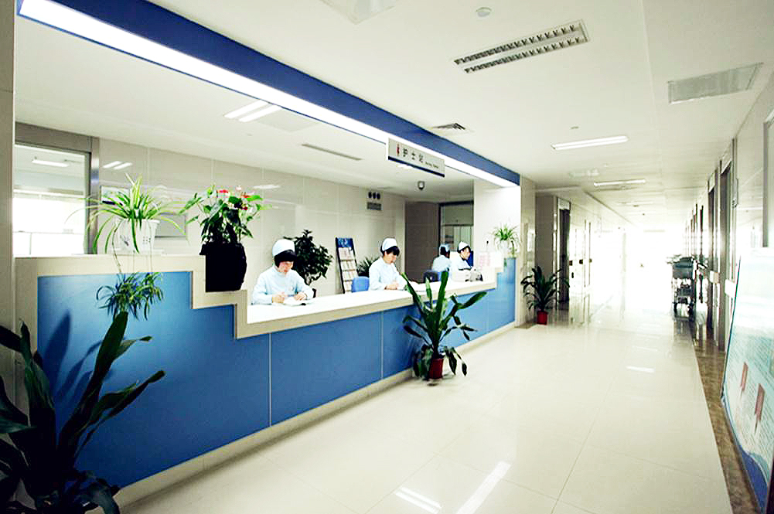
Tradition nursing station
Rely on PC to inquire the nursing information of every ward
Pass the patient information by telephone or pen
Entry the patient information manually

Slide 4
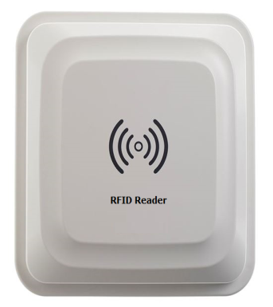
Low working efficiency
Unnecessarily repeated workload
Risk of errors by handwriting
Problems

Slide 5
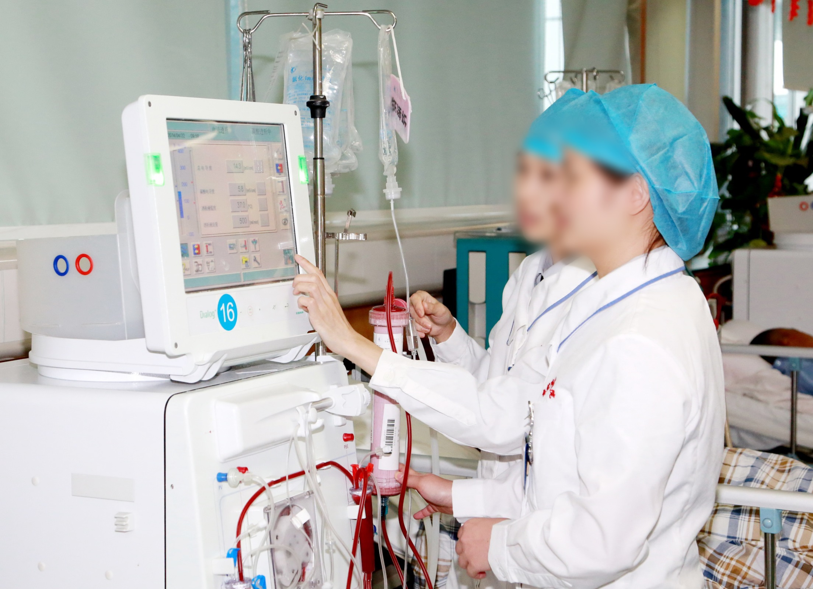
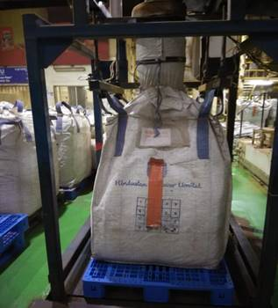
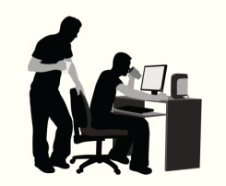
Current systems in Hospital
Connect the hospital’s HIS system with wifi
Scan the barcode of the patient and inquire the related information by connecting the system
Entry medical information in real time
1. DATE & TIME OF PRODUCTION
2. BLEND NAME
3. NET WEIGHT
4. BLEND PAPER NAME
5. MIX NUMBER
RFID TAG
DATA
RFID READER
STALLION SERVER
REPORTS

Slide 6
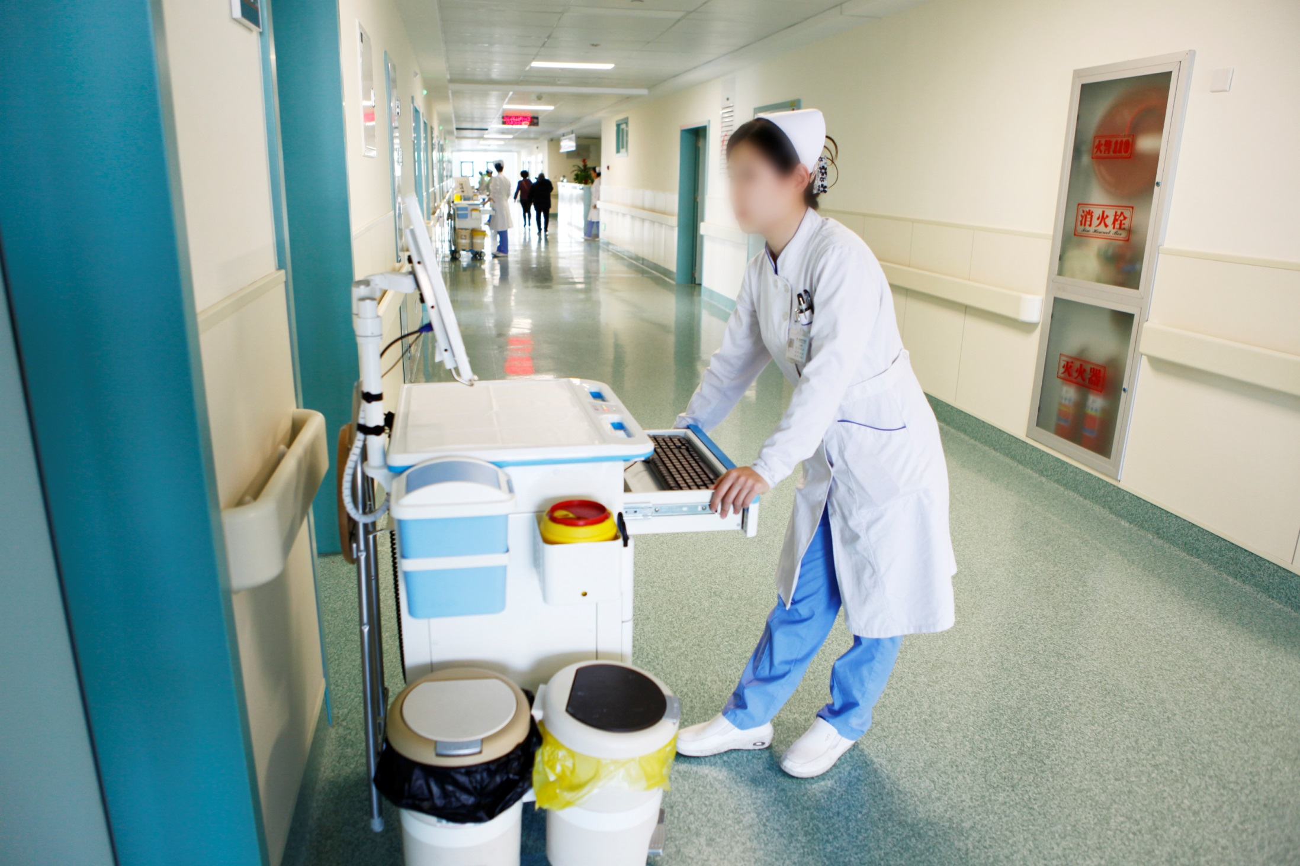
The equipment is bulky and occupies much space of the hospital
The maintenance cost is high
Problems

Slide 7
Suggested Solution
Scan and inquire medication information
Scan and entry nursing information in real time
Improve the working efficiency of the health care staff
Inquire the diagnosis information in real time
Avoid human oversight by automatic task push notification

Slide 8
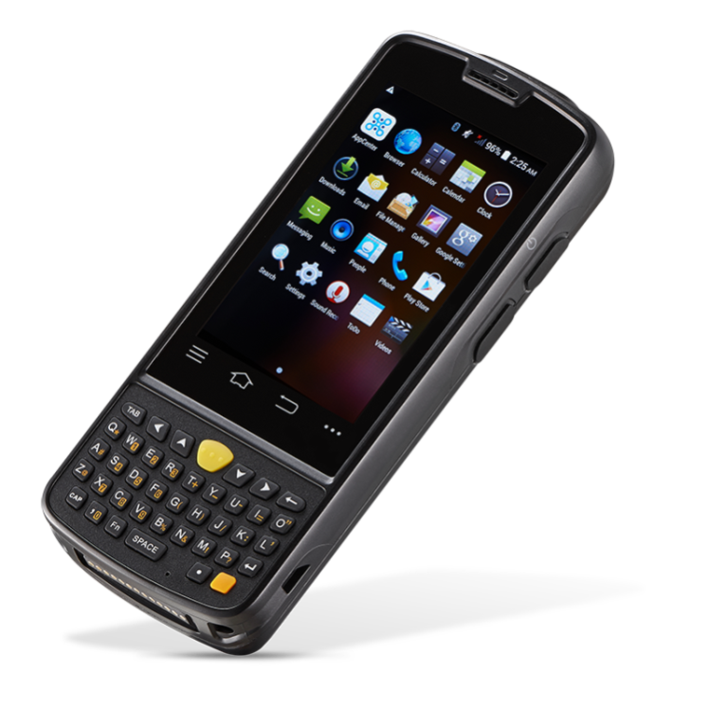
Basic functions in APP
Login of medical personnel
Mobile ward round
Data collection
Meal ordering
Management of the patients
Health Track
Health care project
Inquiry of patients’ information

Slide 9
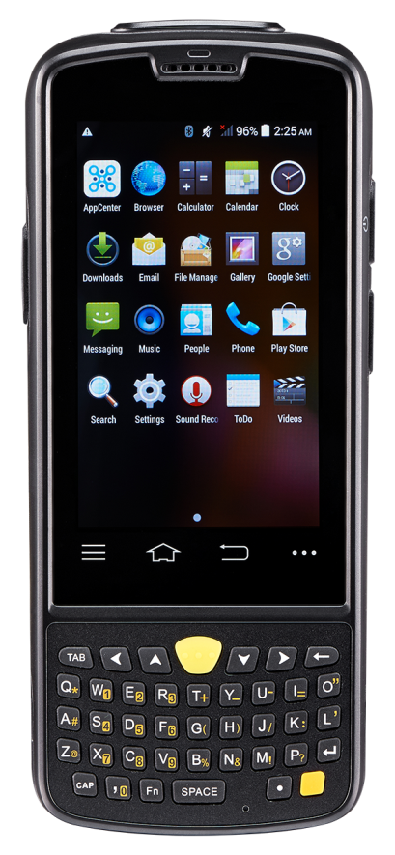
Management of the medication
Begins the treatment
Receive patient
NIS system develops a unique No as RFID / barcode for each patient
App informs the related staff to perform the health care
Dispense
Perform health care
~~~
Match the medicine with the patient
App automatically identifies if the nursing behavior strictly follows the doctor's orders by scanning the barcode of the patient, RFID wristband or the barcode of the medicine
Ends the treatment
Entry the project information of health care
The patient can evaluate the performance of the health care staff
Entry in the system the ID of the medical staff, the treatment process, the time of the treatment and other nursing information

Slide 10
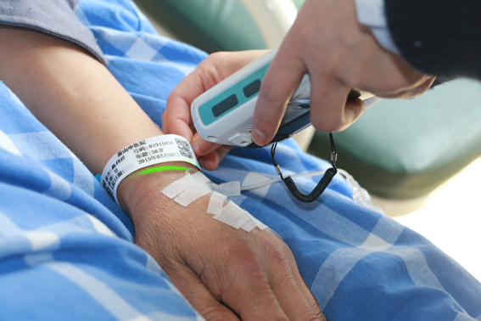
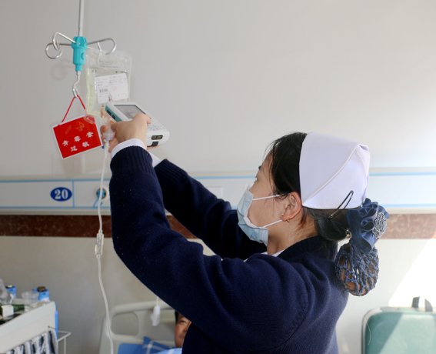
Management of intravenous drip
Scan the RFID Tag or barcode of the patient’s wristband
Scan the barcode of the medicine

Slide 11
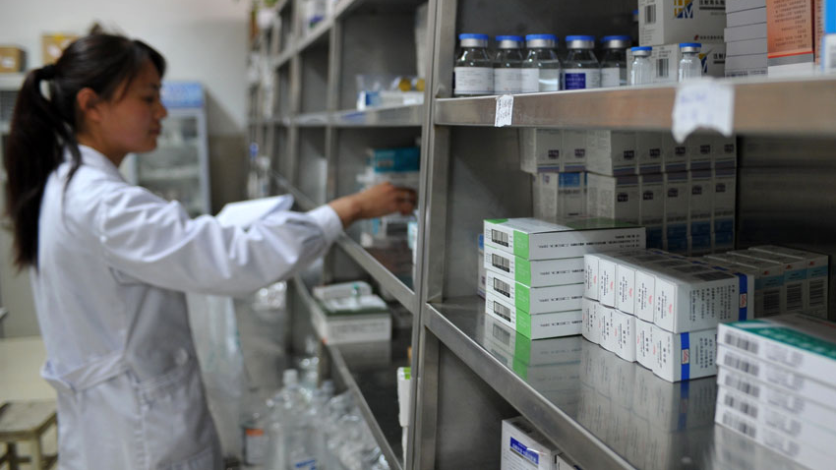
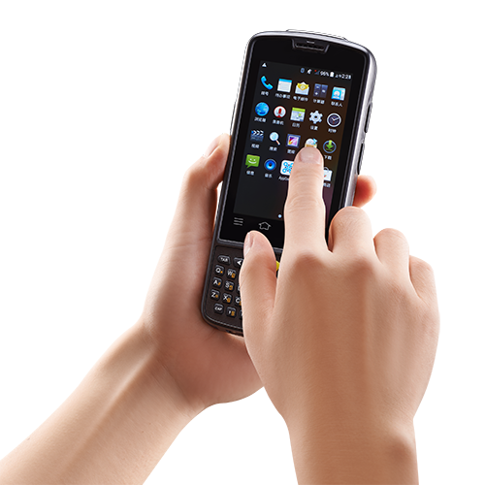
Management of the medication
Record accurately the time of taking medicines
Entry the medicine information

Slide 12
Management of the medication
Record with details the information of health care staff
Standardize medical operations
Record accurately the time of taking meditation
Information is recorded more comprehensively in a more efficient way
Entry the medicine information in real time
Help achieve the loop management of the medicine
Automatically confirm the patient information based on barcode
More secure, faster

Slide 13
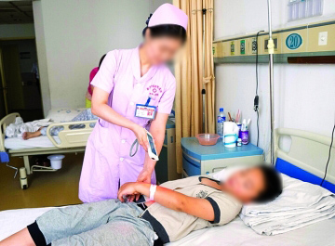
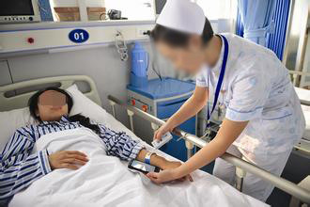
Management of mobile ward round
Inquire in real time the electronic medical records of the patient
Entry in real time the patient's temperature, blood pressure and other symptoms

Slide 14
Management of mobile ward round
Begins the ward round
Standardize the way of performing the ward rounds of medical personnel and the nursing procedure
App pushes the task list based on the data of the NIS system
Related health care personnel login to perform round task
Both the barcode and the RFID tag are unique
Scan the barcode of the patient’s wristband or the RFID
Compared to the tedious manual registration procedures, the PDA registration method works with efficiency, avoids unnecessary paper waste and simplified the steps of entry information
Ends the ward round
PDA automatically brings up the patient information
Health care staff entry the latest information of the patient’s symptoms
Inquire in real time the records of the patients and the details of the health care

Slide 15
Management of mobile ward round Benefits
Real-time
Inquire in real time the patient’s electronic medical records, medication information and treatment information
Convenience
Entry patient's symptoms, reduce the secondary entry
Accuracy
The unique wristband of each patient is the only index to inquire information, which avoids manual transcribed error
Standardization
Real-time inquery of ward round is achieved, which standardizes the operation of health care personnel

Slide 16
Management of the monitoring of critically ill patients
Optimize the monitoring procedures of critically ill patients
Critically ill patients admit to hospital
Strengthen the supervision of health care staff
Doctors arrange nursing care
Nursing staff perform the nursing care
Notification of ward round is pushed at regular intervals
Improve the hospital’s level in information management
Doctors inquire the ward round report
Nursing staff scan the wristbands of the patients and upload the real-time records to the system

Slide 17
Management of the health care follow-up
Improve follow-up system
Patients leave hospital
Improve the quality of treatment and recovery records
Doctors make different plans of health care follow-up to different patients
Collect more cases for clinical application
Automatically generate follow-up report
Increase brand awareness of the hospital
The system automatically arrange medical personnel to perform follow-up tasks
Communicate with patients by messages or calls

Slide 18
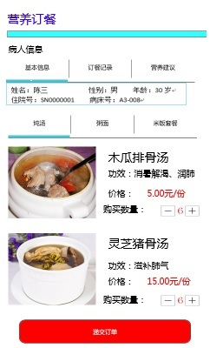
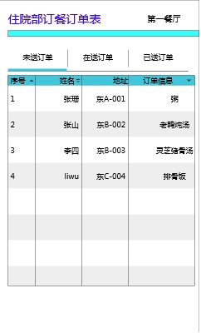
Management of meal ordering (expanded function)
Human services
Track of nutritious meals
Nurses help patient order meals
The restaurant collects information of ordered meals

Slide 19
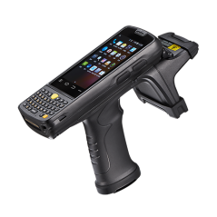
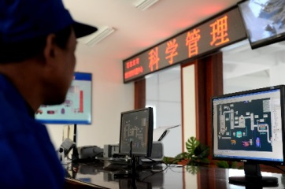
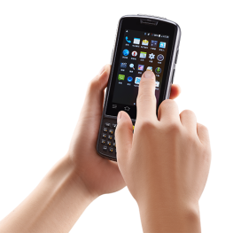
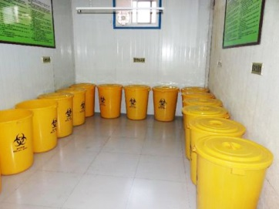
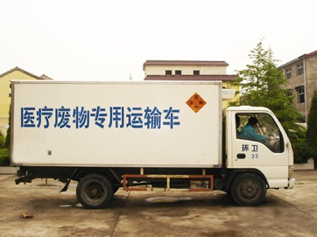
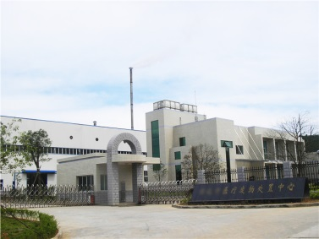
Management of the medical waste (optional)
PDA scan
RFID tag
Medical Waste Management Center
PDA conforms the reaching of the medical waste
Medical waste center of the hospital
Transporter for the medical waste
Medical waste processing center

Slide 20
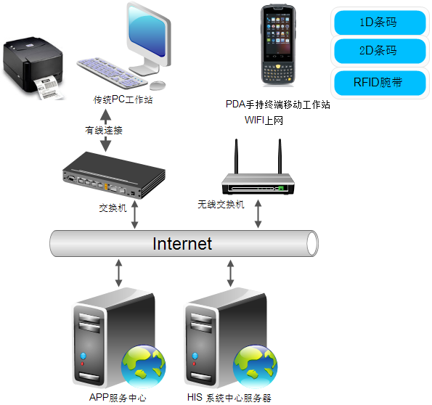
Hardware architecture scheme
1D barcode
2D barcode
Seamless compatibility with the original systems
RFID wristband
Traditional PC workstation
PDA handheld terminal mobile workstation
With WIFI
Wired connection
Flexible deployment with low cost
Portable device, easy to carry
Switch board
Wireless switch board
Android system, easy to use
Integrate functions of scanning RFID of one-dimension and two-dimension, WIFI, camera and 4G network
App service center
HIS system center server

Slide 21
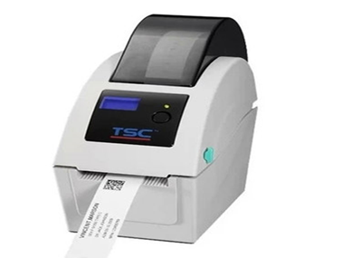
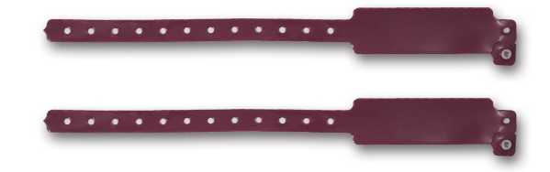
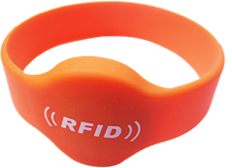
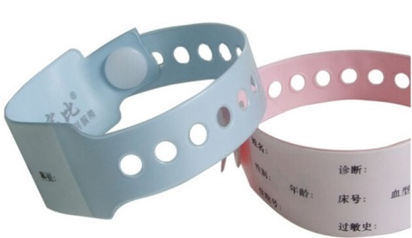
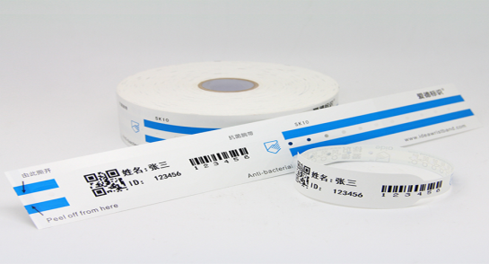
RFID Wristband Model

Slide 22
Thanks You
THANK Y
For your wathcing

